Slide 1
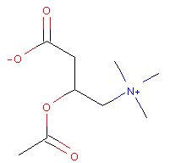
Figure 1: Workflow of structure-based drug classification pipeline.
Training Data
2D drug images
Structure-based Deep Neural Network Classifier
1. Classes: MeSH Therapeutic Use
2. Examples: Drugs, PubChem CID#
pubchempyRDkit
Transfer Learning
Cardiovascular Agent
Central Nervous System Agent
Convolutional Neural Network
Anti-neoplastic Agent
ResNet
Pre-trained Model

Slide 2
Figure 2: Loss among training and validation sets:
Validation-set #s from Aliper, A., et al. Mol. Pharm. (2016):
 | SVM | DNN | CNN + Transfer Learning
3-class | 0.530 | 0.701 | 0.748
5-class | 0.417 | 0.596 | 0.650
12-class | 0.366 | 0.546 | 0.580
 | precompute=T 1000 epochs, k=10 | precompute=T, then F, k=5 | Precompute =T, then F, then unfreeze
3-class | 0.745 ± 0.00989 | 0.895 ± 0.00641
5-class | 0.632 ± 0.0108 | 0.844 ± 0.00567
12-class | 0.538 ± 0.0148 | 0.783 ± 0.0106

Slide 3
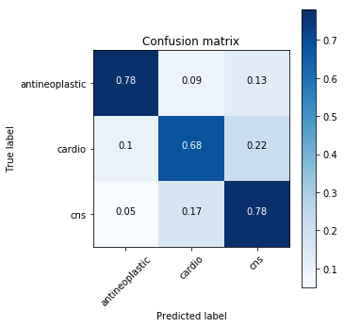
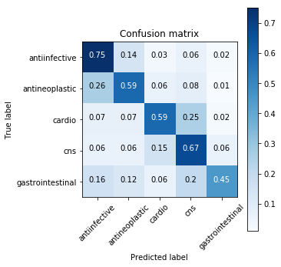
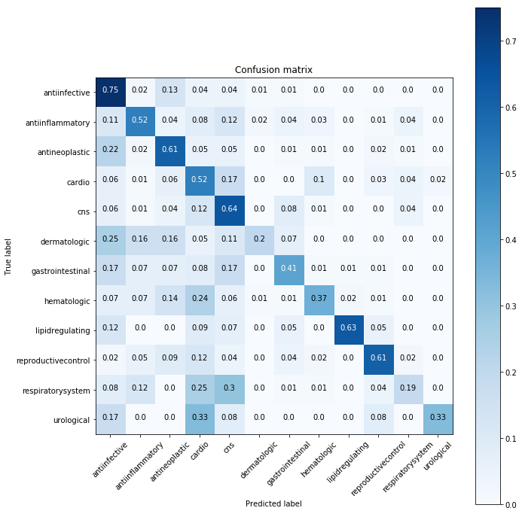
Figure 3: Confusion matrices of classification performance over sets of drug molecules belonging to (a) 3, (b) 5, and (c) 12 therapeutic classes. Each matrix is the classification using the random 20% validation set. Each confusion matrix is a random representative of the ten models from the 10-fold cross validation.
a
b
c

Slide 4
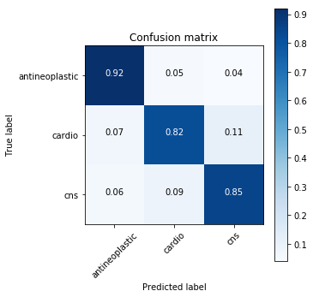
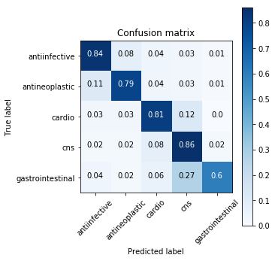
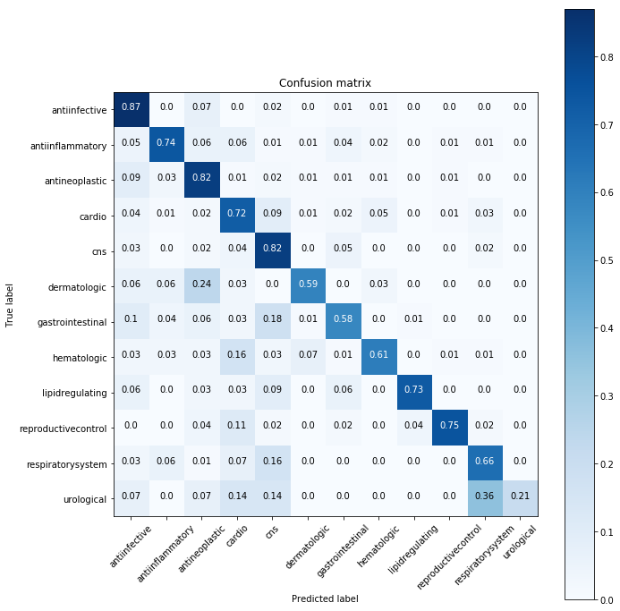
Figure 4: how accuracy on abundant and low abundance classes changes with more epochs?

